Slide 1








IHE-HL7 Gemini MDI SDPi+FHIR – Hanging Gardens Guided Tour
for
Joint IEEE / HL7 / IHE Working Group Meetings
2021.01.27 (Finalized 2021.02.18)
FHIR is a trademark of Health Level 7, International.
SDC is a registered trademark of OR.NET

Slide 2
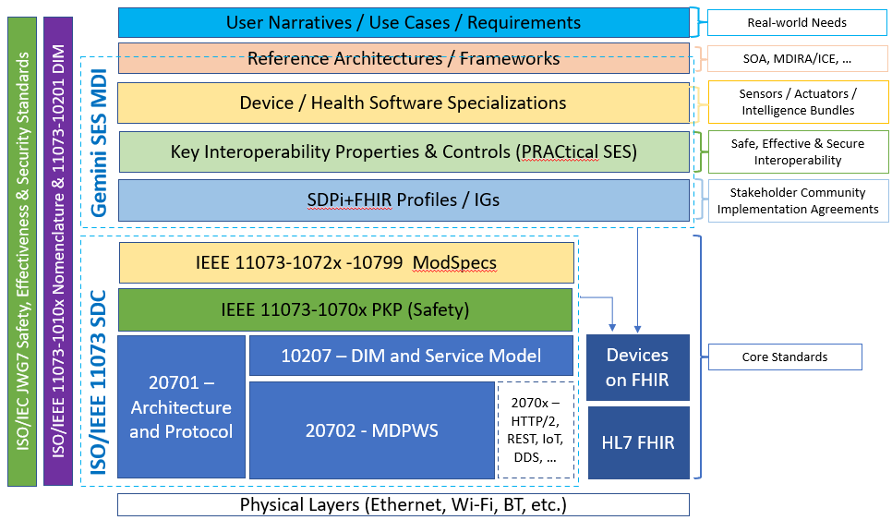
Gemini SES MDI using SDPi+FHIR
Gemini SES MDI / SDPi+FHIR – Year 3 Update!
Focus Topic: Do all roads lead to … Devices on FHIR Destination?!
Focus Topic: IHE TF Publications – Accelerating the Evolution
Focus Topic: Is a strategy emerging for Traceability from Use Case Requirements to Conformity Assessment?

Slide 3
Gemini SES MDI / SDPi+FHIR – Year 3 Update
Actually, longer than that … and a quick look at recent years gives a very positive expectation for this 3rd year of SDPi+FHIR!

Slide 4
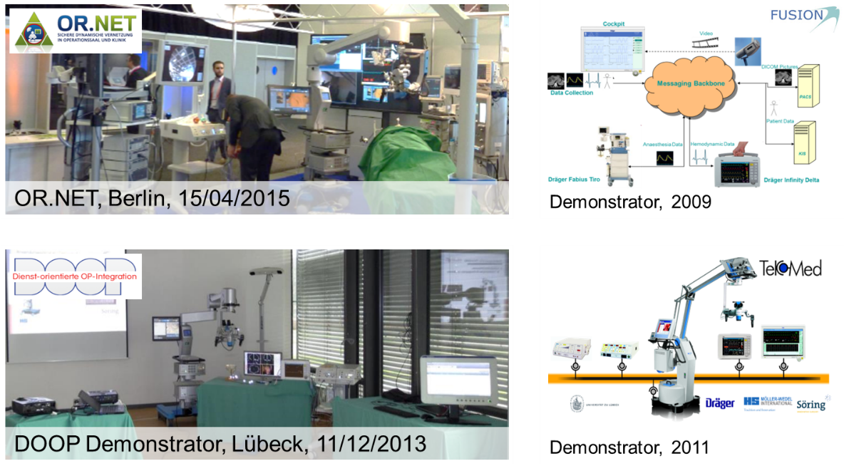
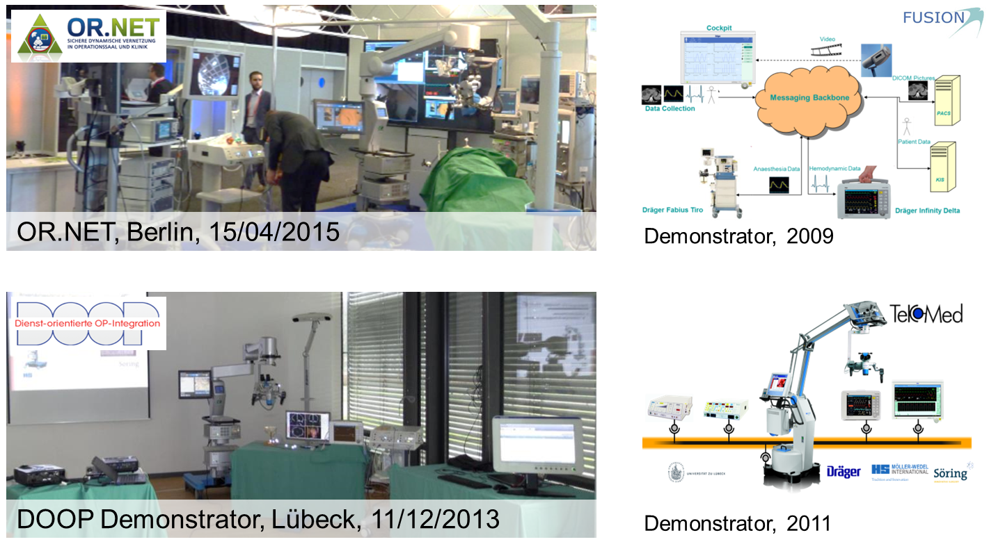


Prehistory: ISO/IEEE 11073 SDC – 15 Year Journey
2004
2004
2010
2011
2013
2015
2016
2017
2018
BMBF Vision SOMIT FUSION / OrthoMIT
Foundation for the idea of interoperability
TekoMed
Feasibility study to prove the SOA approach for medical devices
Dienst-Orientierte OP Integration (DOOP)
Networking project with various medical vendors to implement DPWS and demonstrate interoperability
BMBF-OR.NET
A project funded by the German Ministry of Education and Research to consolidate all medical device interoperability research activities in Germany
OR.NET Consortium
An association of different stakeholders in medical device interoperability
IEEE 11073-20702 Standard approved
Medical Devices Communication Profile for Web Services
IEEE 11073-10207 Standard approved
Domain Information and Service Model for Service-Oriented Point-of-Care Medical Device Communication
IEEE 11073-20701 Standard approved
Service Oriented Medical Device Exchange Architecture & Protocol Binding
NOTE: This roughly parallels the timelines for IHE Devices Domain & HL7 Devices WG

Slide 5
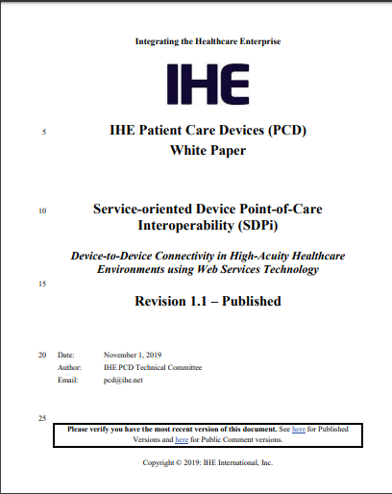
SDC/SDPi+FHIR: Year 1 (2019) Visioneering
Year 1 Milestones
Published SDPi White Paper & Use Case Compendium
Conference briefings from Germany to North America to Australia & Asia
IHE SDPi Supplement development approved and initiated
IHE Devices rebranding / reorganization initiated (at the 15-year anniversary mark!)
https://www.ihe.net/uploadedFiles/Documents/PCD/IHE_PCD_WP_SDPi_Rev1-1_Pub_2019-11-01.pdf
https://wiki.ihe.net/index.php/SDC@IHE_White_Paper

Slide 6
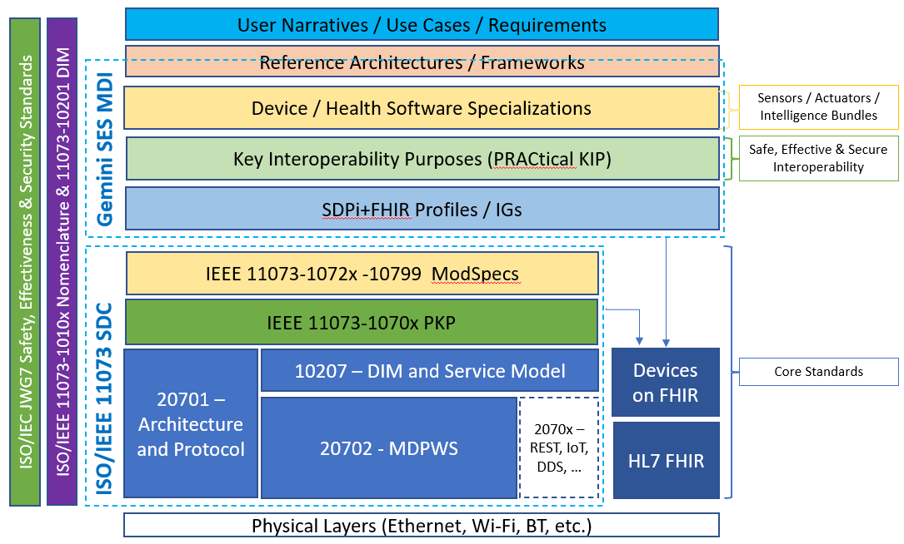
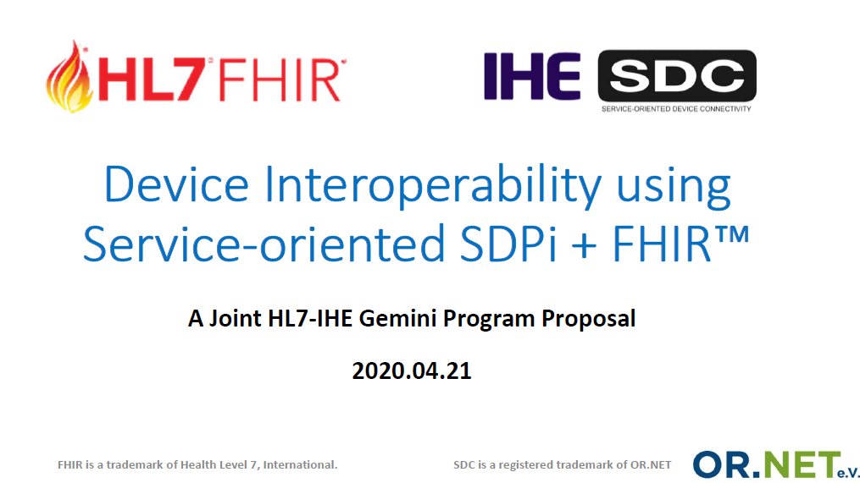
SDC/SDPi+FHIR: Year 2 (2020) The Journey Begins
What didn’t exist before 2020.01.01!
Year 2 Milestones
Health Challenges … Everywhere & Everyone
Tobias & Todd @ HIMSS’20!
“Layers” Model => Hanging Gardens Model
Joint HL7-IHE Governance Established in Gemini SES MDI!
IHE DEV/DPI operationalized / HL7 DEV Rebranded
ISO/IEC Coordination via TR’s for SES MDI & SES RCC/MH
ISO/IEEE 11073 SDC –
“Cathedral” Model
Multiple Standards / Specifications
Multiple Organizations / SDOs
Multiple Projects / Initiatives

Slide 7
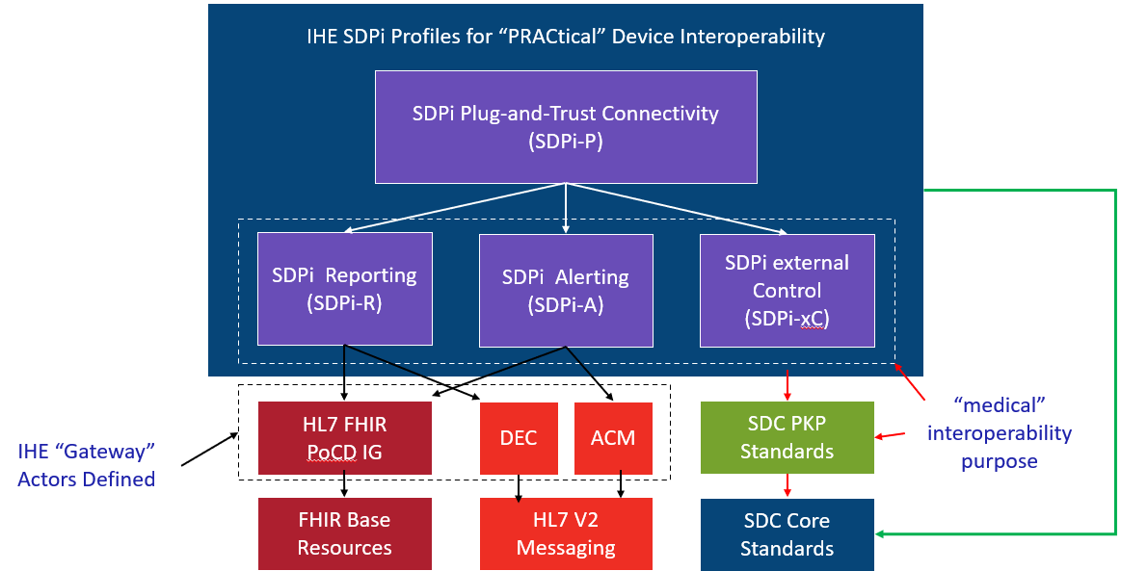
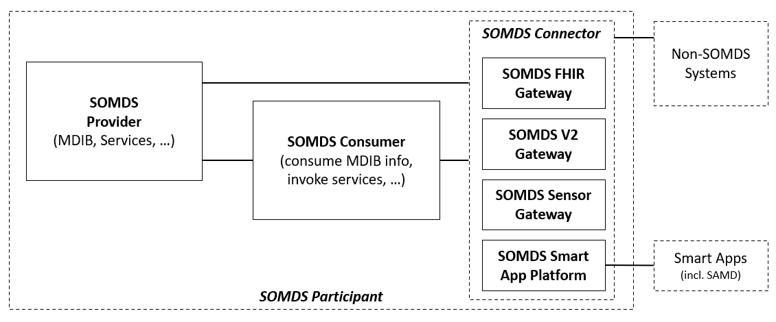
SDC/SDPi+FHIR: Year 2 (2020) The Journey Begins
Year 2 Milestones
SDPi Supplement Crafting begun in earnest … starting with the profiles framework
Gemini MDI Community formed
Coordinated use of HL7 Confluence & IHE Github
Initial Actors & Transactions defined
Enhanced Use Case specificity & TF integration + “Silent PoC” detailed
Initial SDC/BICEPS reporting & alerting mappings for DoF PoCD IG crafted
MDI SDC Security approach advanced
1st IHE DE SDC/SDPi Plug-a-thon!
Source: SDPi-P Actor Diagram

Slide 8
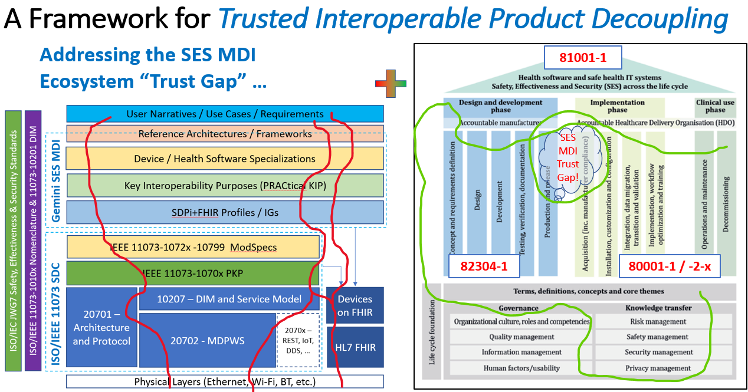
SDC/SDPi+FHIR: Year 2 (2020) The Journey Begins
Year 2 Milestones
“SES MDI” identified as a foundational concept …
Integration of MDI technical standards w/ SES Quality & Regulatory process standards …
Like real-world products do!
EU “Notified Bodies” discussions advanced & OR.NET position paper published & initial IEEE 11073-10700 PKP standard draft out for review
See OR.NET downloads for papers @ https://ornet.org/en/download/

Slide 9
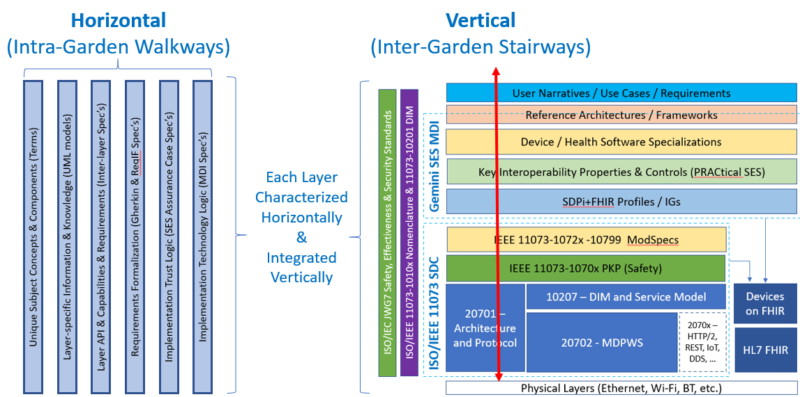
SDC/SDPi+FHIR: Year 2 (2020) The Journey Begins
Year 2 Milestones
New level of requirements management and Conformity Assessment (CA)
Use of Gherkin & ReqIF evaluated to achieve traceability from use case narratives & scenarios to component product specification & testing
Goal: CA test reports that can be directly used for regulatory submissions + certification of Plug-and-Trust products

Slide 10
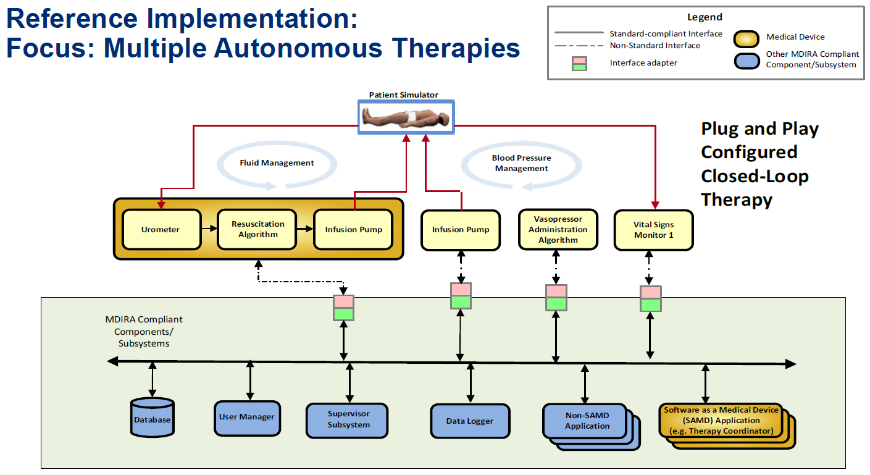
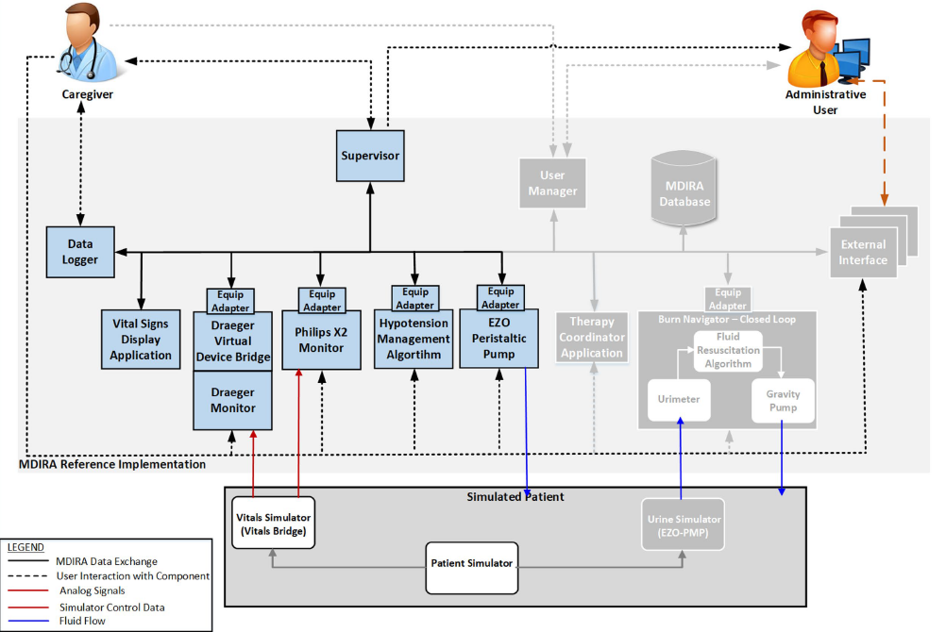
SDC/SDPi+FHIR: Year 2 (2020) The Journey Begins
Year 2 Milestones
JHU/APL MDIRA crafts an SDC-based reference implementation
IHE DEV approves MDIRA Brief Profile Proposal for an SDPi+FHIR based specification
NOTE: MDIRA motivated definition of Hanging Gardens Framework layer
And we survived 2020, but with close-to-home heart felt losses: Christophe Fournier & Bill Majurski
Source: JHU/APL MDIRA Update to IEEE/IHE/HL7 DEV WGM 2021.01.25

Slide 11
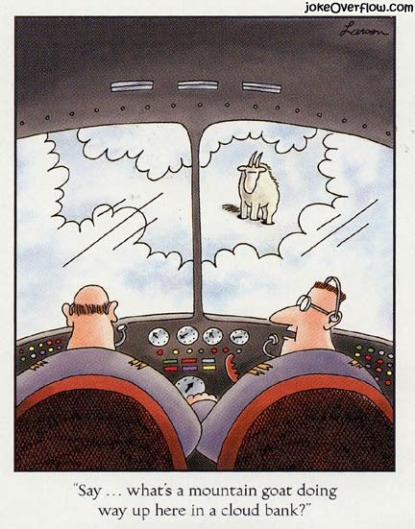
SDC/SDPi+FHIR: Year 3 (2021) 1st Summiting!
Year 3 Milestones
Reach the first summits!
Publish SDPi Supplement 1.0 (June ‘21), draft 2.0 (December ‘21)
Publishing 1.0 using emerging IHE tooling (incl. Github repo => HTML)
Stretch Goal: IHE DEV TF 2021 Edition published from Github
IHE & HL7 Plug-a-thongs & Connectathons
Tailored for emerging specifications (virtual & low budget!)
Regular cadence ~ monthly events
Use Cases & Demonstrations, including focus on:
Silent Point of Care (SPoC) / Silent ICU
Isolation Point-of-Care (IPoC)
Drafting MDIRA profile supplement
Initial (80%?) draft … requires coordination w/ SDPi TF
(View from an Isolation Point-of-Care Cockpit …)

Slide 12
SDC/SDPi+FHIR: Year 3 (2021) 1st Summiting!
Year 3 Milestones
Requirements Requirements Requirements
Integration (Gherkin->ReqIF) across Hanging Gardens Layers (at least a few!)
Tooling Tooling Tooling
Leverage existing & emerging while advancing next generation support
Education Education Education
Must be better at briefing SES MDI using SDC/SDPi+FHIR to all audiences
Community Community Community
Must expand the developer/adopter community!
Must expand engagement of the SES Quality & Regulatory community

Slide 13
Focus Topic: Do all roads lead to … Devices on FHIR Destination?!
Considerations in light of the HL7 V2-to-FHIR Project

Slide 14
Devices in FHIR – Multiple paths … Same Destination?
Since DoF launched in 2016 June …
Consider the current paths for device informatics in HL7 FHIR constructs:
DoF PoCD IG – Maps ISO/IEEE 11073 PoCD (Classic & SDC) + IHE DEV/PCD V2 profiles
(https://build.fhir.org/ig/HL7/uv-pocd/index.html)
DoF PHD IG – Maps ISO/IEEE 11073 PHD + IHE DEV / PCH profiles
(https://build.fhir.org/ig/HL7/PHD/TechnicalImplementationGuidance.html)
V2-to-FHIR Project – Maps the HL7 V2 specification (across all uses) to FHIR constructs
Question: With these multiple paths … will we end up with a consistent integration of device informatics in HL7 FHIR ecosystems?

Slide 15
Devices in FHIR – Multiple paths … Same Destination?
Emerging path: HL7 V2-to-FHIR Project
Project (led by HL7 OO) is nearing in ‘21 ballot … it is real, here & now!
Project maintained in Github repository: https://github.com/HL7/v2-to-fhir
Published in HTML a la FHIR: https://build.fhir.org/ig/HL7/v2-to-fhir/
Observations: Message Mappings VERY similar to DoF IG work (e.g., spreadsheets with 11073 PHD on the left, FHIR on the right)
Status Notes:
Limited number of messages (but ORU is included!)
Pulled from January ‘21 Ballot due to the need to “bake” it some more

Slide 16
Devices in FHIR – Multiple paths … Same Destination?
At end of 2021 … will all paths lead to the same DoF destination?
Goal: Consistent integration of device informatics within FHIR-based ecosystems
HL7-IHE DEV support specifications using V2 messaging, 11073 PoCD & PHD semantics, SDC BICEPS & communications … and FHIR
SDPi+FHIR includes “SOMDS Connector” bidirectional gateways … including for FHIR
DoF Implementation guides consistently map 11073 semantics to FHIR resources
V2-to-FHIR will be baked into products & open source tooling, etc.
Question: Will the V2-to-FHIR message mappings (esp. for ORU profiles) be consistent with existing HL7-IHE DEV DoF specifications?
Who / how / when … will this automagically happen? (not a rhetorical question … time to engage is NOW!)

Slide 17
Focus Topic: IHE TF Publications – Accelerating the Evolution
Oft heard:
Do we have to keep these monolithic Word / PDF spec documents?
Can’t we become more like … HL7 FHIR publication in HTML?
It’s the 20’s … can’t we do better?!

Slide 18
IHE TF Publications – Accelerating the Evolution
Current state & challenges for IHE Technical Framework Publication
Goals and Objectives of committee managing IHE use of HL7 IG publisher
ITI TF Publication rolled out (https://profiles.ihe.net/index.html)
IHE Publication Project (https://github.com/IHE/publications/)
IHE “supplement template” project (https://github.com/IHE/supplement-template)
Status of publishing @ ihe.github.io?
Publication at profiles.ihe.net represents a huge step forward … but …
Does this get us to where we really want to be? How does it compare to the V2+ work?

Slide 19
IHE TF Publications – Accelerating the Evolution
Consider the analogous HL7 V2+ project
HL7 V2 is analogous: Word/PDF documents … pain pain pain
V2+ Project aims to publish V2 in a way very similar to HL7 FHIR
And the Tooling is 1st Class, with our amazing Master Tool Builder: Michael Faughn!
Project repository: https://github.com/HL7/v2-to-fhir
HTML Publication: https://v2plus.hl7.org/2021Jan/index.html

Slide 20
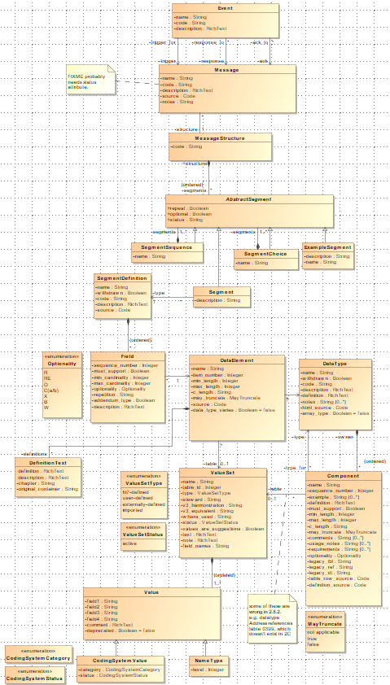
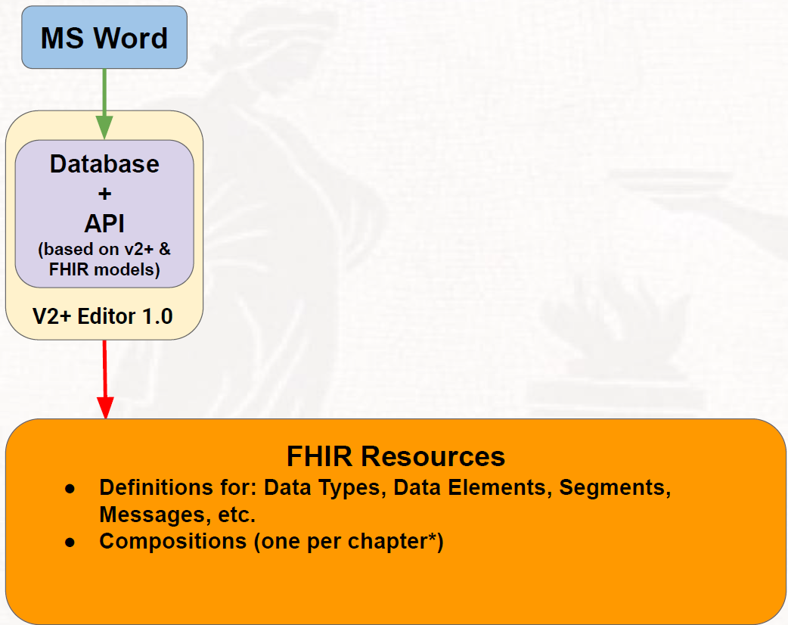
IHE TF Publications – Accelerating the Evolution
HL7 V2+ Project Review
(note: Non-normative V2 UML model!)
Source: Michael Faughn/Prometheus

Slide 21
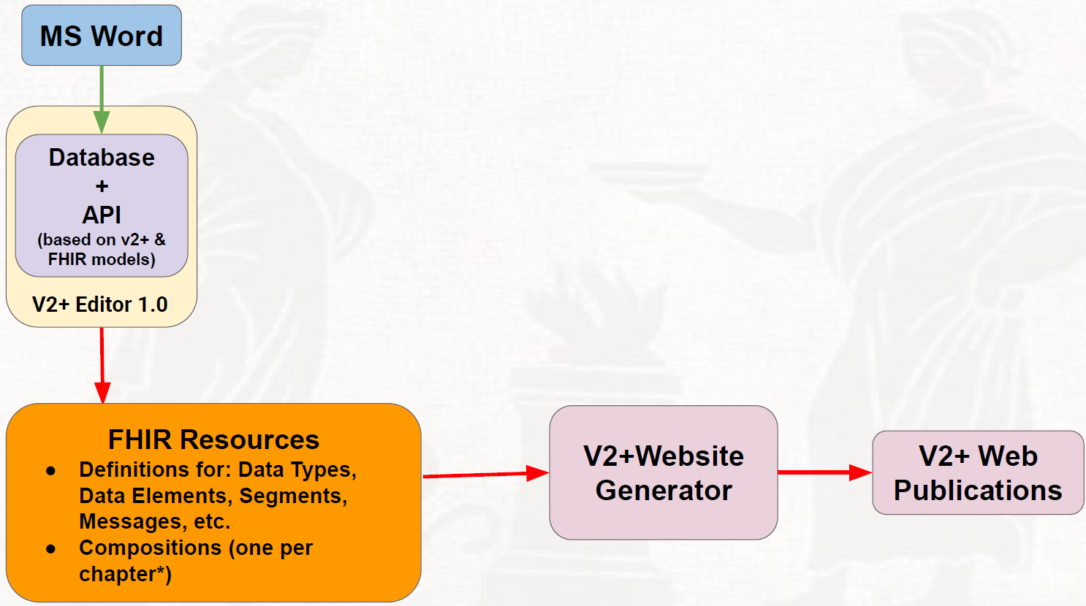
IHE TF Publications – Accelerating the Evolution
HL7 V2+ Project Review
Source: Michael Faughn/Prometheus

Slide 22
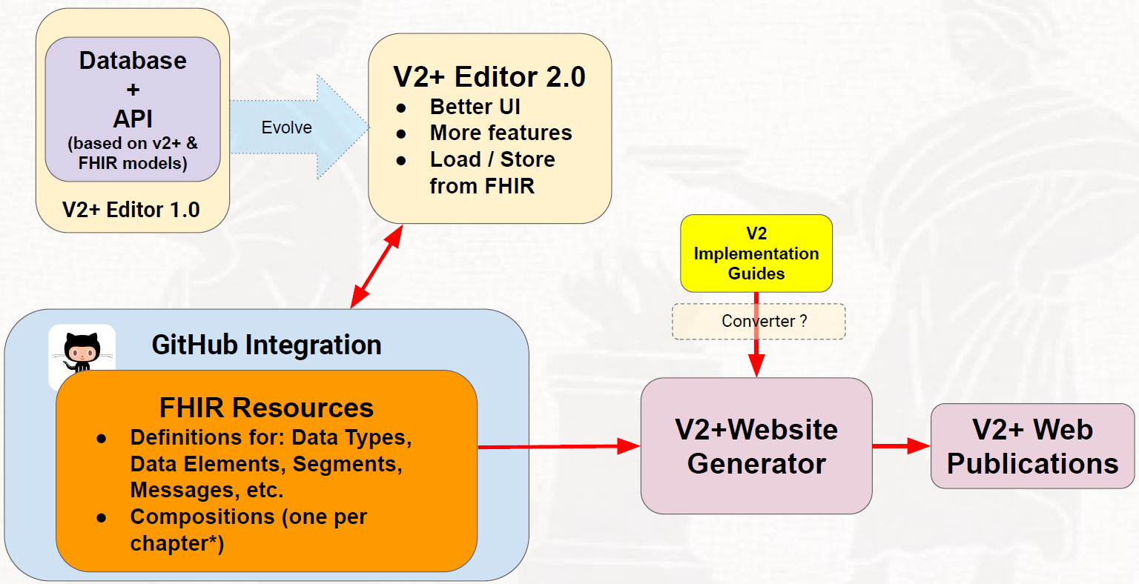
IHE TF Publications – Accelerating the Evolution
HL7 V2+ Project Review
Source: Michael Faughn/Prometheus

Slide 23
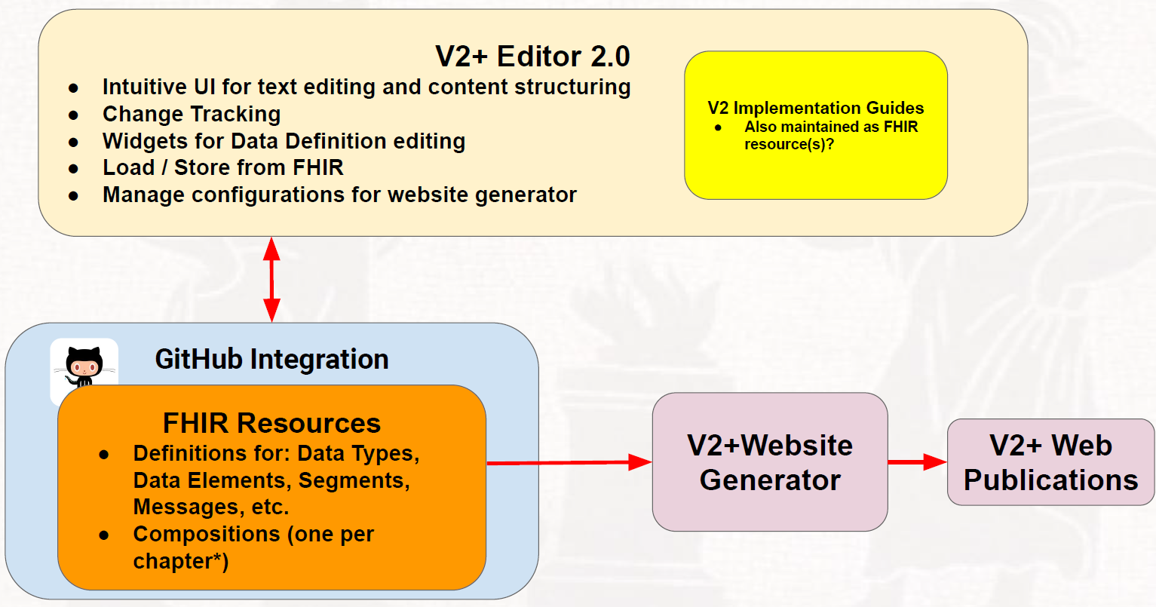
IHE TF Publications – Accelerating the Evolution
HL7 V2+ Project Review
Source: Michael Faughn/Prometheus

Slide 24
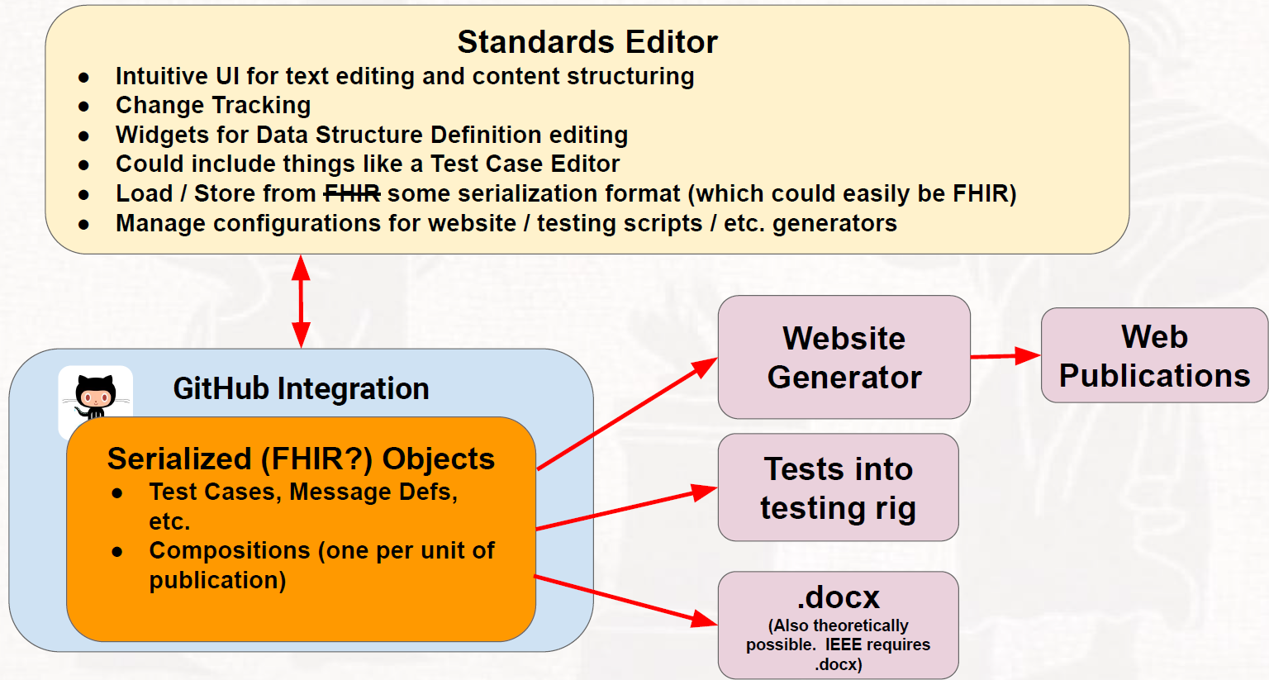
IHE TF Publications – Accelerating the Evolution
HL7 V2+ Project Review
Source: Michael Faughn/Prometheus

Slide 25
IHE TF Publications – Accelerating the Evolution
The 2021 Path Forward?
Can we leverage the current ITI publication process (github => IG Builder => HTML)?
Can we leverage the tooling approach crafted for HL7 V2+ Project? (V2+4IHE!)
What is the role of tools like NIST IGAMPT? Usable for more than V2-based profiles? Integratable?
Can we chart a path through 2021 to start with what we CAN do and move to a more robust – SME & User Friendly! – future state?
Discussion:
See Michael Faughn’s initial “feasibility” study (xml & HTML rendering)
What would an IHE TF HTML “site” look like?
Refactoring of IHE TF pages (only dynamically published from github repo’s)
Integrated specifications like HL7 FHIR (but without the messy IG Builder!)
What additional markup would we want to include (e.g., ReqIF ready!)
Include IHE DEV TF 2021 and integrate at https://profiles.ihe.net/index.html?

Slide 26
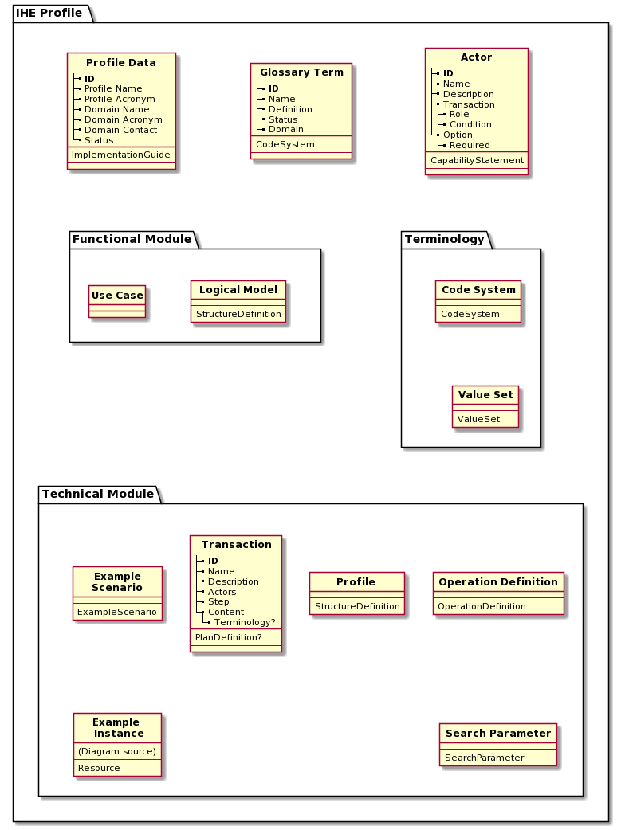
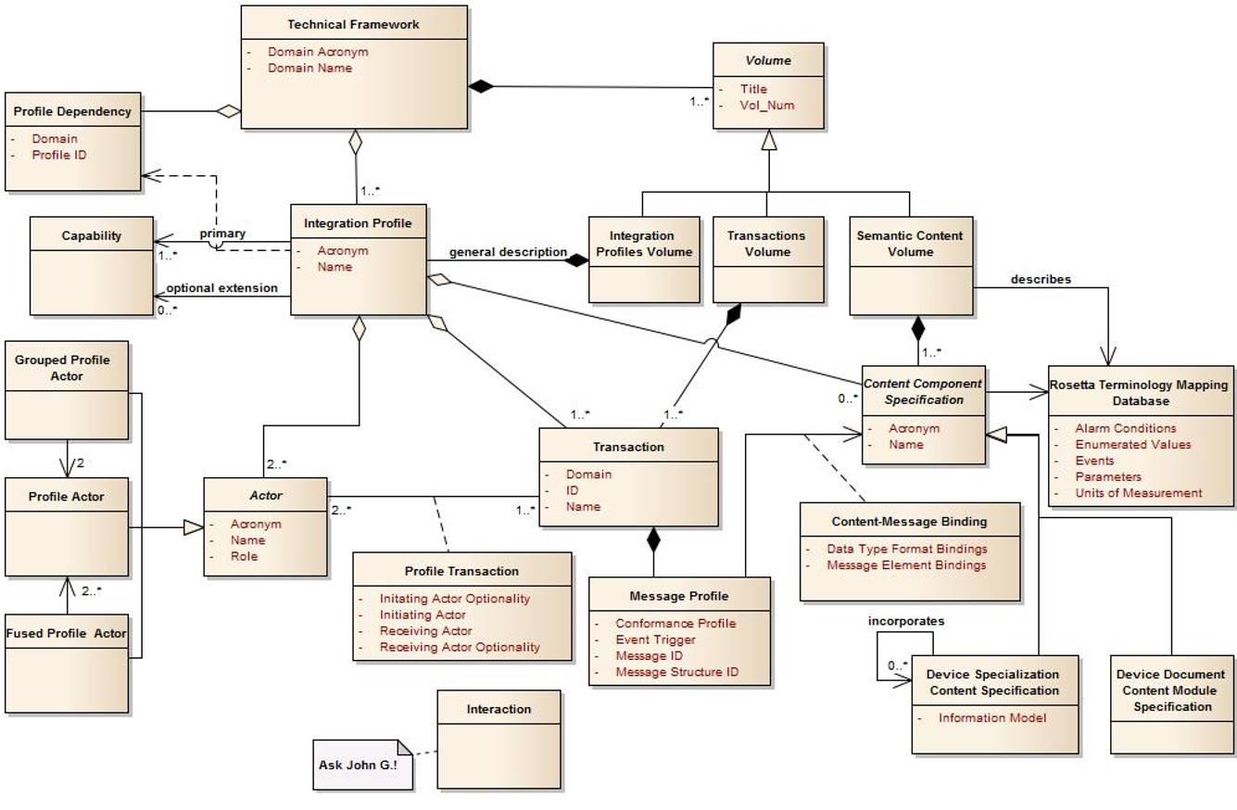
IHE TF Publications – Accelerating the Evolution
Source: IHE FHIR IG (http://build.fhir.org/ig/IHE/ihe-model-ig/branches/master/intro.html )
Discussion:
Expand & update IHE TF Models to match current & future relationships?
Source: 2019 IHE SDPi White Paper

Slide 27
IHE TF Publications – Accelerating the Evolution
2021.02.10 Update (after ITI Publication Discussion w/ Moehrke)
Discussion “Takeaways”:
All efforts are in experiment stages … NOTHING is finalized as “The IHE Approach”
ITI has (4) Different HTML Publication Approaches: TF vs. White Paper vs. Supplement vs. FHIR-based IHE IG … and they are all “experimental”
profiles.ihe.net will be used long term for publication of IHE profiles
ihe.github.io used for “pre-staging” draft content incl. for group review & comment
“HIE White Paper” created in markdown but the ITI TF FT will be maintained & edited in HTML only
https://github.com/IHE/publications is where all published content is maintained and, in some cases, managed (e.g., vs. ITI TF FT but not FormatCode which has its own repo)
‘22 on … no PDFs!
Used PanDoc for Word-to-Markdown … OTHER TOOL for Word-to-HTML (ask Martin Smock)
FSH / Sushi used (https://github.com/FHIR/sushi) for MHD integration with IG Publisher
See also “gen-html.bat” tool on IUA Supplement (https://github.com/IHE/ITI.IUA)
For example, may be a one liner script to call PanDoc

Slide 28
IHE TF Publications – Accelerating the Evolution
2021.02.10 Update (after ITI Publication Discussion w/ Moehrke
SDPi Pilot Project Next Steps :
Craft updated IHE TF UML Model that integrates / supports the CA strategy below
Define a model-aligned set of Word styles that can be leveraged by the V2+ front end tool
Review the various IHE & V2+ HTML publications look-and-feel to craft a target for SDPi
IUA would be a preferred starting point (https://profiles.ihe.net/ITI/IUA/index.html)
ITI TF HTML at profiles.ihe.net
Consider MHD HTML also (http://build.fhir.org/ig/IHE/ITI.MHD/branches/master/index.html)
Near Term: Utilize the V2+ tooling for HTML publication
See gitlab.com/prometheuscomputing/v2fhir
Longer Term: Move toward the “Standards Editor” WYSIWYG vision for the project, informed by the UML model & SDPi Supplement development & publication
Word Free & FHIR IG Publisher Free & Markdown/HTML Editing Free … Future
Note: “free” = Not required but can use if and when appropriate
OPEN ISSUE: What to do / IF to do for the 2021 IHE Devices FT for HTML Publication … ??
Schedule regular “IHE Publication Automation” meeting for those advancing pilot projects

Slide 29

IHE TF Publications – Accelerating the Evolution
Later (’21++)
Sooner (now!)
Prometheus Standards Editor Deluxe
IHE TF UML (+ ReqIF CA) Model
TF Content Authoring
(MagicDraw)
(see preceding V2+ graphic for 2.0 Editor)
IHE TF Word Styles
…
(Word Export to PDF)
(Word .docx )
IHE ReqIF Artifacts
(see subsequent CA slides)
TF Content Management
IHE Github
(Repos/Projects/Issues)
V2++ “Editor 1.0”
(special IHE edition!)
Ihe/sdpi-fhir
Ihe/dev ???
ihe.github.io
(Continuous Build)
(Public Comment)
V2++ FHIR Resources
TF Publication
github.com/IHE/publications/DEV
www.ihe.net/resources/technical_frameworks/#dev (PDF)
V2++Website Generator
profiles.ihe.net/DEV/SDPI (html)
Indicates logical flow (via Github)

Slide 30
Focus Topic: Is a strategy emerging for traceability from Use Case Requirements to Conformity Assessment?
Gemini SES MDI initiative looks to raise the bar for navigating from detailed use case requirements specifications to CA testing reports that can be used directly for regulatory purposes. Is there a clear strategic path to achieving this … in our lifetime?!

Slide 31
Use Cases to CA: From vision to reality?
Two key questions:
Big Picture: Can a course be charted from where we are today … that’s worth embarking on?
and
Traceability: Can this be achieved in a Hanging Gardens world?

Slide 32
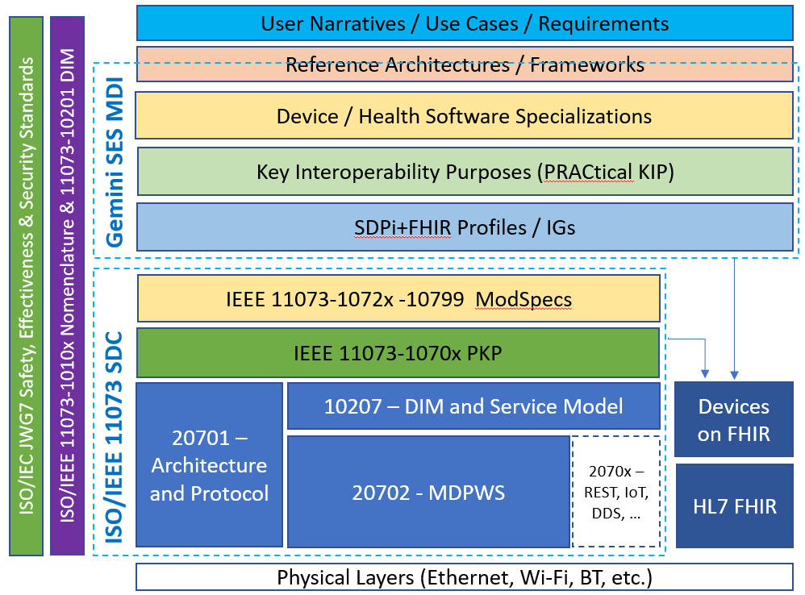

Charting the course from narratives to interfaces
SDPi+FHIR Grand Vision: Traceability from Narrative/Use Cases to Plug-n-Trust Interfaces!
Each “layer” specifies requirements to be mapped to the next
Each “layer” adds its own set of requirements
Requirements align with safety, effectiveness & security (SES)
NOTE: Null layers allowed but generally required to achieve the SES Plug-n-Trust objective.
/ Ecosystem
Comprehensive System Function Contribution (SFC) Plug-n-Trust Interfaces

Slide 33
Orientation Tour: From Volume 1 to 2 to 3
Remember the organization / integration of the SDPi Supplement …
SDPi TF Supplement Vol.1 Integration Profiles
SDPi-P Profile
Profile Actors & Transactions & Content Modules
Profile Actor Options
Profile Overview (Concepts & Use Cases)
SES Considerations
SDPi-Reporting Profile …
SDPi-Alerting Profile …
SDPi-xControl Profile …
Appendix A: Requirements Management for Plug-n-Trust Interoperability
Appendix B: ISO/IEEE 11073 SDC Requirements Coverage
<including ISO/IEEE 11073 SDC ICS tables>
Appendix C: Device Point-of-care Interoperability Use Cases
<including Gherkin detail & links to Compendium etc.>
SDPi TF Supplement Vol.2 Transactions
DEV-23 Announce Network Presence
Scope
Actor Roles & Referenced Standards
Messages (at BICEPS level w/ links to Appendix A)
Protocol Requirements
SES Considerations
DEV-24 Discover Network Participants
…
DEV-44 Invoke Medical Control Services
Appendix A: ISO/IEEE 11073 SDC / MDPWS Message Specifications (Normative)
SDC/BICEPS to SDC/MDPWS Message Specifications
Messages for BICEPS Discovery Model
<specific MDPWS message links>
<example exchanges & library calls>
MDPWS Message Detail in Appendix
M:N Profiles & Transactions
See SDPi Supplement (1.0) document in the IHE sdpi-fhir Github repository for full details.

Slide 34
Requirements: From Use Cases to CA Test Scripts
Consider the following … “From Use Case requirements”
SDPi TF-1
Profile <X>
Profile Use Case Requirements Gherkin Feature Files
Use Case Bindings / Implementation
3
Profile Requirements (general)
4
2
Gherkin to ReqIF Transform
SDPi-FHIR Github Repository
Bindings
(M:N)
Appendix B IEEE 11073 SDC ICS Tables
… <ISO/IEEE 11073-20701 ICS Table w/ SDPi column>
???
ReqIF Test Script / Platform Generator
Appendix C MDI Use Cases
3
Profile (General Non-Use Case) ReqIF Specification File(s)
Isolation Bed Use Case
Narrative
Technical Preconditions (Background)
Scenario
Given … When … Then …
5
1
Use Case Based Profile Test Script(s)
Use Case Gherkin Feature Files
NOTE: TF-2 & TF-3 requirements management not included but would leverage the same approach.

Slide 35
Requirements: From Use Cases to CA Test Scripts
Consider the following … “to Conformity Assessment”
[Multi-Layer] Profile ReqIF Specification(s)
SES MDI ReqIF Interface Profiler
ReqIF-based IHE TF Product Implementation Profile Specification
(see pre-/post-slides)
Gazelle Test Management Platform
(see NIST Device Profiling Tools)
Profile Test Script(s)
Use Case Based Test Cases
Product Test Case Requirements to support CA of claims per SUT Interface Specification
General Requirements Test Cases
Product Test(s) Requirements
System Under Test
(SDPi Actor(s))
SDPi+FHIR Test Execution Platform
CA Test Report
(w/ ReqIF traceability)
System Interface Specification (incl. SFC)
SDPi
SOMDS Network
(Trust Evidence for Computable Assurance Cases)
Note: Not all Gazelle & Test Platform Tooling capabilities identified.

Slide 36

Layer Characterization: Horizontal & Vertical
Remember from 2020 Hanging Gardens discussion …
Horizontal
(Intra-Garden Walkways)
Vertical
(Inter-Garden Stairways)
Unique Subject Concepts & Components (Terms)
Each Layer Characterized Horizontally
&
Integrated Vertically
Layer-specific Information & Knowledge (UML models)
Layer API & Capabilities & Requirements (Inter-layer Spec’s)
Requirements Formalization (Gherkin & ReqIF Spec’s)
Implementation Trust Logic (SES Assurance Case Spec’s)
Implementation Technology Logic (MDI Spec’s)
How?!

Slide 37
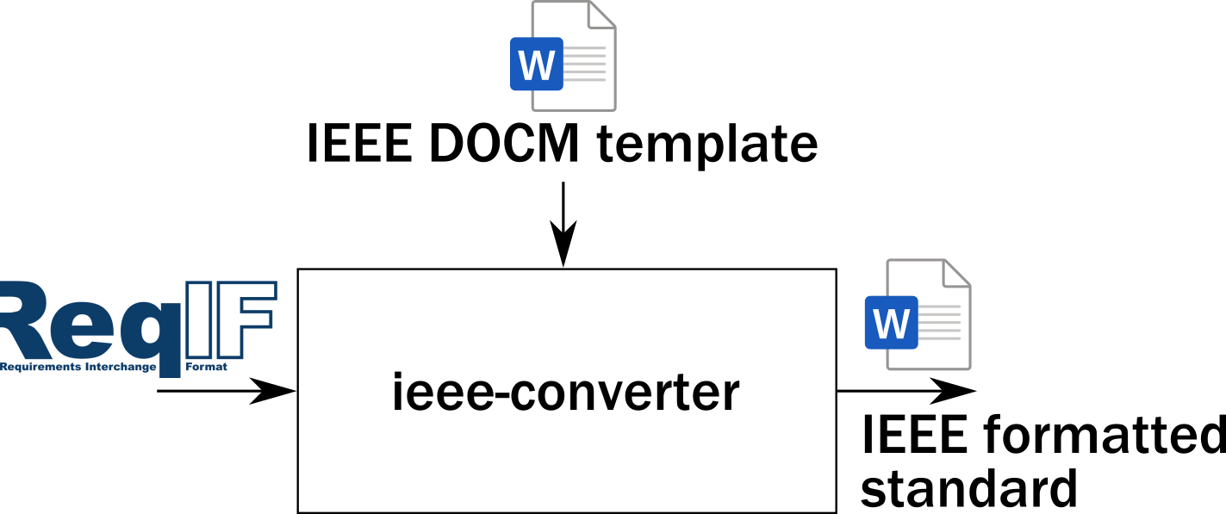
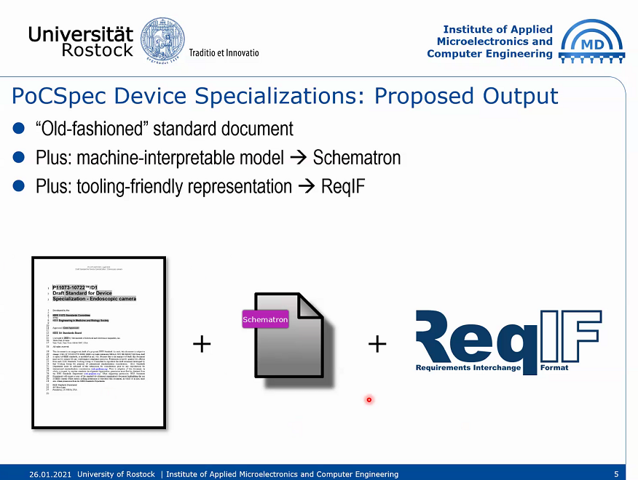
ReqIF sightings in the gardens …
ReqIF to Word
Note: Though Requirements Interchange Format (ReqIF) does not ensure inter-layer requirements integration out-of-the-box, it is increasingly used and as a result, found supported by many requirements management system tools.
Word to ReqIF

Slide 38


Requirements: From Use Cases to CA Test Scripts
Consider the following … “Traceability in a Hanging Gardens World”
Layer ReqIF Meta-Model *
Layer Requirements Specifications
(see ReqIF SpecHierarchy Model)
Layer Capabilities “API” Specification
ReqIF “Layer Mapping” Tool
Implementation / Realization Req’ts
Computable Assurance Case Specification(s)
Inter-Layer Mapping Specification(s)
SDPi + MDIRA Pilots could include:
General Use Cases (Appendix C)
“MD-SOA” & MDIRA/ICE Architectures
IEC 80001-1 2nd Edition
SDPi+FHIR & MDIRA Profiles
IEEE 11073-10700 PKP
IEEE 11073 SDC Core Standards
(see preceding slide)
Multi-Layer Profile ReqIF Specification(s)
Requirements Interoperability!
* “ReqIF Meta-Model” will include requirement classification “attributes” / SpecTypes for “user views” and grouping (e.g., func/non-func).

Slide 39
Requirements: From Use Cases to CA Test Scripts
The 2021 Path Forward?
What is the best path forward for formalizing capture of these requirements? (one that can be expanded as additional profiles & standards & organizations are integrated)
How can a “new” IHE TF approach incorporate this level of requirements specification and traceability?
Should we even bother with a tool like Cucumber Studio? Is there an open source Cucumber/Gherkin “syntax” tool that would be better to use? PROBABLY NOT
NOTE: Many IDE & editors support “syntax highlighting” for Gherkin
Is the ReqIF Studio tool needed? Sufficient? PROBABLY NOT
…

Slide 40
Yes … there’s more!
Additional information … if the preceding didn’t quench your thirst!

Slide 41
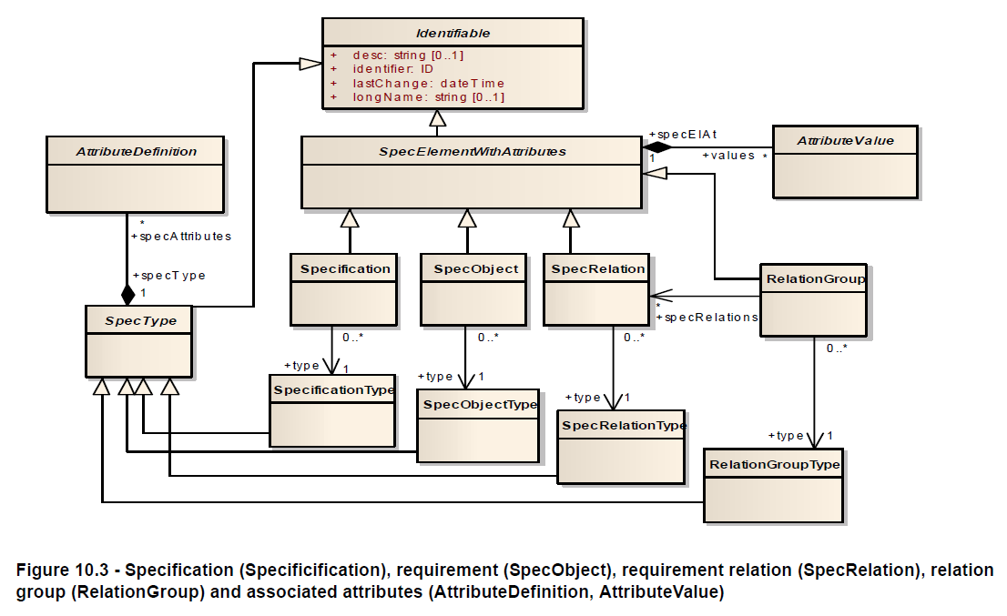
OMG ReqIF: Base Model
See also: ISO/IEC/IEEE 29148:2011
Systems And Software Engineering - Life Cycle Processes - Requirements Engineering
Source: OMG Requirements Interchange Format (ReqIF) Standard

Slide 42
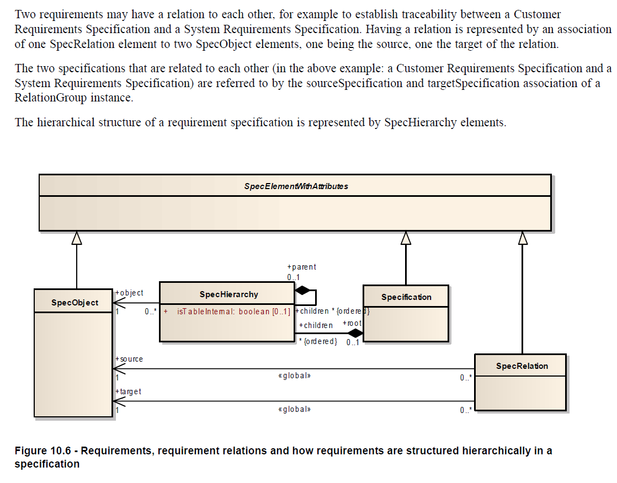
ReqIF: Requirement Hierarchies & Relationships
“mapping” between
Source & Target Requirements
Source: OMG Requirements Interchange Format (ReqIF) Standard

Slide 43
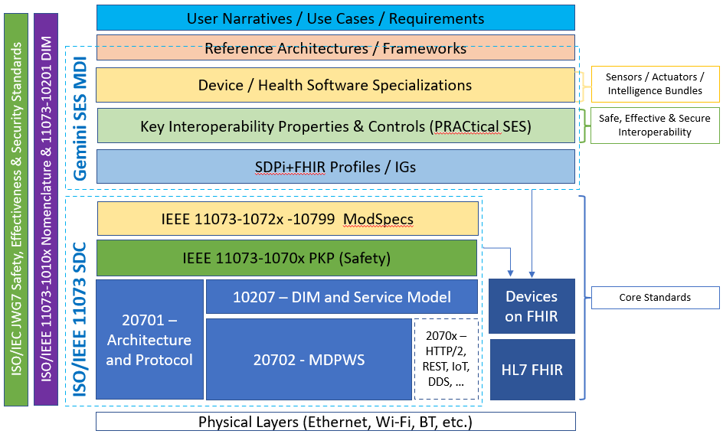
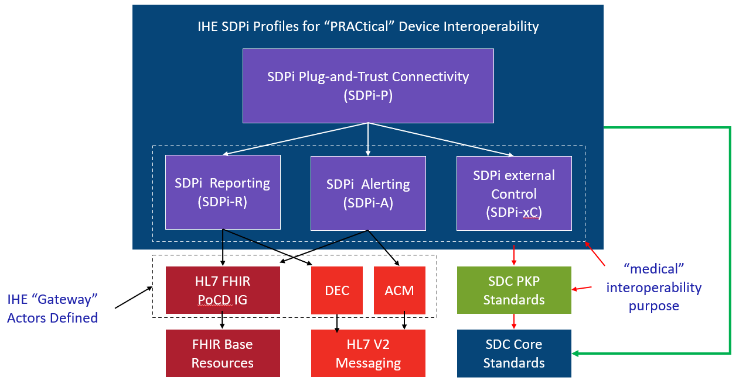
Hanging Gardens: After SDPi 1.0 …
NOTE: Profile Titles are notional – hopefully useful too!
Devices-In-Care (PDP) Profile
Device Specialization Profile
Surgery PoC Profile
ICU PoC Profile
MDIRA ICE Profile
SOMDS@home Profile
IHE (Official) Profile Types:
Transport, Content, Workflow
Or a combination of all (3)
Other types?
Architecture (SOA, MDIRA, SDC, ….?
Single domain / multi-domain?

